Slide 1
Some architecture example slides
Serving as role model for NTDO App architecture figures for the paper

Slide 2
Integrated
NTDO annotated RDF Data set
Normalization
Normalized & anonymized SQL DTB
SIM Mortility DTB
(dBase)
Temporal queries and reasoning ()via rules, etc)
NTDO SPARQL Endpoint
Normalized & anonymized SQL DTB
SINAN Morbidity DTB
(dBase)
NTDE-user interface(GUI)

Slide 3
What about machines?
Prescription Patient 1 | 2 times a week | AMOXICILIN | etc.
Ontology 1
Ontology 2
AMOXICILIN
AMOX.
Error: Don’t know that drug
They don’t adapt, yet…
They are still comparing data to match, even at the concept level -> even with “semantics”
We need to align: structures, terms, etc.

Slide 4
Working Hypothesis
Domain
Ontology
Many standards for information models (HL7, openEHR), for terminologies (ATC, NEWT, ICD10) and for knowledge management (SNOMED CT, BioTop, DOLCE, etc.) are out there
We do not impose any of them as a top-down approach yet we make sure a unique domain consistent view is generated from DebugIT data,
The IP should be scalable to the extent of the European medical centers.
Annotated
ATC:AMOXICILIN
SNOMED:AMOXICILIN
Rules 1
AMOXICILIN=ATC:AMOXICILIN
Rules 2
AMOX.=SNOMED:AMOXICILIN
Global as Local as View Approach
Data Ontology 1
Data Ontology 2
AMOXICILIN
AMOX.

Slide 5
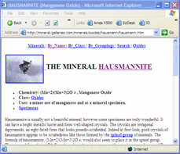

Integration Problems/Approaches
Native Data Sources
Problems:
Data sources store data in different formats and speak different “languages”
Data sources don’t capture meaning of data
Data sources don’t capture user’s world view
Database
User
Approach:
Use the language of ontologies (RDF) as a the common format in which to perform integration
“Wrap” all data sources so they appear to store their data in RDF
Develop data source ontologies to capture meaning of data in native sources
Develop an integrated ontology to describe the user’s world view of the merged data
Develop translation rules that allow you to map vocabularies across sources
Web Service
Integrated
Data Source
Web Page
Excel file

Slide 6
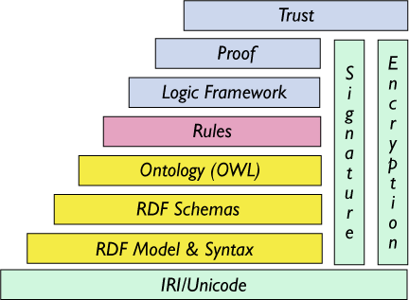

Slide 7
Funktionale Schichten
Mensch-Maschine
Interaktion
Nutzer
interface
Nutzer
Anwendung
Anwendungs-spezifischer
Code
Service
interface
Domänen-spezifischer
Code
Mediation
Quellen-Zugriff
interface
Wrapper
Quellen-spezifischer
Code
Real-world
interface
Datenquelle

Slide 8
Schnittstellen
X-Widgets,
HTML, Java
Nutzer
Mensch ↔ Maschine
Anwendung
Web
Services
Anwendung ↔ Mediator
Mediation
SQL, XML
Mediator ↔ Datenquellen
Wrapper
Sensoren,
Sachbearbeiter
Datenquellen ← Welt
Datenquelle

Slide 9
Standard (XML-Based) Mediator Architecture
USER/Client
Query Q ( G (S₁,..., S_{k}) )
Integrated Global
(XML) View G
Integrated View
Definition
G(..)← S₁(..)…S_{k}(..)
MEDIATOR
(XML) Queries & Results
(XML) View
(XML) View
(XML) View
wrappers implemented
as web services
Wrapper
Wrapper
Wrapper
S₁
S₂
S_{k}

Slide 10
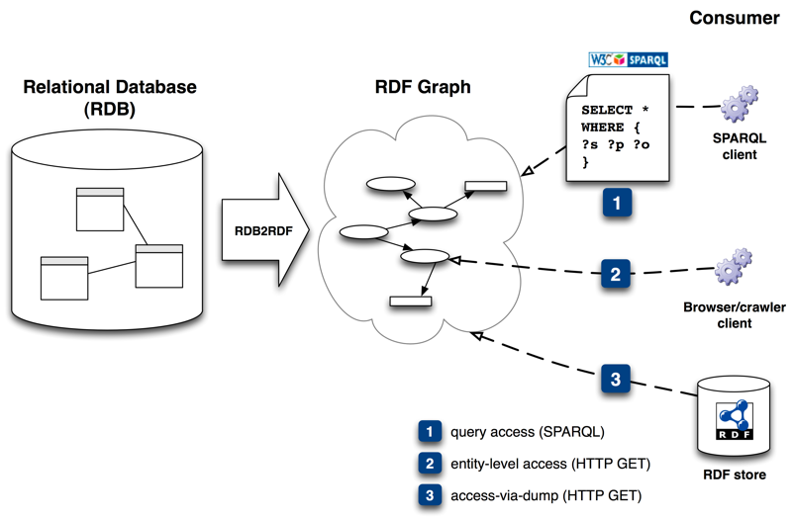
Overview

Slide 11
Mediator-Wrapper Architektur
Anwendung 1
Anwendung 2
Externe Schemas
Föderiertes Schema
Mediator
Export Schemas
Komponenten Schemas
Wrapper 1
Wrapper 2
Wrapper 3
Lokale Schemas
Quelle 1
Quelle 2
Quelle 3

Slide 12
A prototype architecture
*possible use of JDBC metadata to obtain db descriptions
*ontologies can be created and modified via Protégé-2000 tool; underlying format is RDF
(Data Warehouse environment, e.g. SQL Server)
Ontology Server
Source
db 1
Target
db
Mediator
Interface 1
Abstractions
(Relational DBMS, e.g. MySQL)
*alternatively, a common metadata exchange standard such as XMI could be used
Data
Descriptions
*abstraction model in the ontology is extensible to any domain
Source
db 2
Data
Mappings
Mediator
Interface 2
Warehouse
Mediator
Transformation
Descriptions
(Object-Relational DBMS, e.g. Postgresql)
*XML data binding could be used to generate APIs for data validation or transformation
*possible use of XSLT to perform data transformations
*key goal: develop the ontology server as a component, use EJB or .NET

Slide 13
Semantic Interoperability Platform (SIP)
A simple thing (?) ☺
Put a semantic layer on top if any resource
Define a common ontology (formal domain description)
Query data as if everything behaves as one virtual system
Virtual and consolidated
information
source
Semantic Interoperability Platform
Semantic layer
Semantic layer
Semantic layer
Semantic layer
Semantic layer
Information
source
Information
source
Information
source
Information
source
Information
source

Slide 14
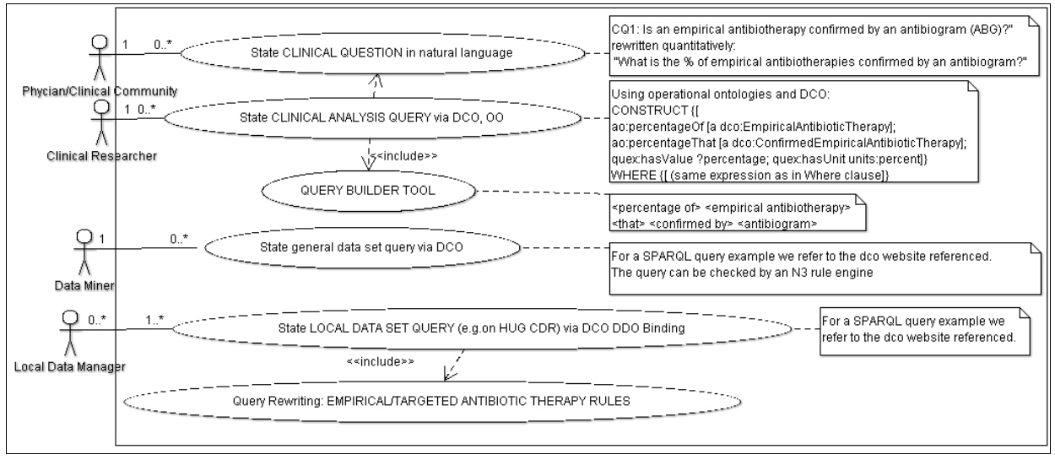
UML Use Case diagram illustrating Ontology usage in formalisation steps for competency question

Slide 15



Mediator-Integrator layered Architecture (Deverlopment time)
Query
Template Generation
Acess:
GUI Layer
Result Set
Query specification
Question Authoring Tool
Clinical Analysis Query, CASQ in DO
N3 Data mining Rules
Semantic Integration:
Integration Layer
Knowledge
Repository
(SPARQL-DO)
Domain
Ontologies
Semantic
normalization
Data Set Query, DSSQ in DDO
Syntactic
Integration:
Mediation Layer
(SPARQL-DDO)
Global vCDR
DDO2DO Conversion
N3 Rule Generationm
Virtual CDR
Local wrapper
(DDO) for Local CDR
…
Syntactic & shallow semantic normalization
Freiburg DDO
Endpoint
Paris DDO
Endpoint
D2R mapping calls
Lexical normalization
terminology standards
Local CIS
(DB)
…
Freiburg CIS
Paris CIS

Slide 16

Querying Workflow
Domain
Dataset
Local
Datasets
dashboard
Domain
Ontology
Data Sources
?
Domain
Clinical Query
Template Generated Dataset Queries

Slide 17
Data Miner (retrieve clinical data)

Slide 18
Sequence diagram for analysis

